Slide 1
EXERCISES
Chapiter 2

Slide 2

Celebrating exercise
Notes:
At age 91 Grace was still active playing tennis, lifting weights, and walking. Fifty-one years before, however, at the age of 40, her condition had been very different. Grace’s spine was badly injured during a ski accident that occurred at the time, and as the years passed her back pain intensified. Her physician told her that he couldn’t do much to help her because she was “too old.” Grace later was diagnosed with emphysema and had difficulty breathing. She tired easily and at one point feared that she would never be able to climb stairs again. The doctor offered her no hope of improvement.

Slide 3
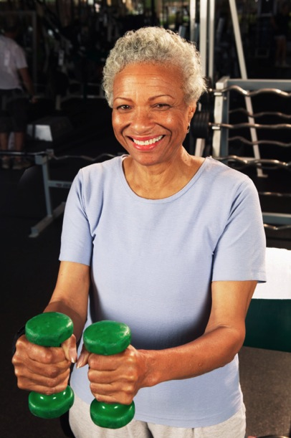
She worked out, 3 times a week
Notes:
Grace, however, had a strong will to recover and decided to try an exercise program offered at a local medical center. For six weeks she worked out three times a week, two to three hours a day. She lifted weights, walked on the treadmill, rode the stationary bicycle, and did breathing exercises. Even when she was in pain and didn’t feel like doing anything, she didn’t quit. Eventually, her breathing improved and the back pain disappeared. She was able to walk reasonable distances—and had energy to spare! Her doctor told her that he had never seen such progress in anyone her age. Grace attributes her health improvement to exercise.¹

Slide 4
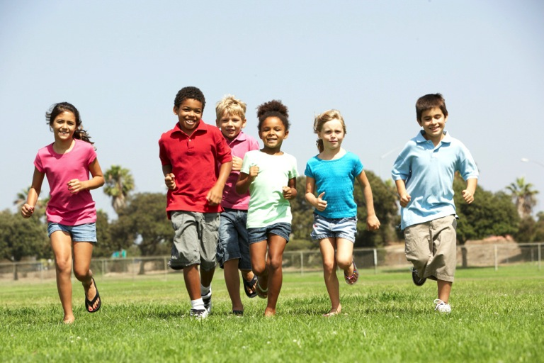
Benefits of physical exercise
Notes:
Exercise is a form of physical activity that is planned, structured, repetitive, and performed with the goal of improving health and fitness. So although all exercise is physical activity, not all physical activity is exercise.

Slide 5
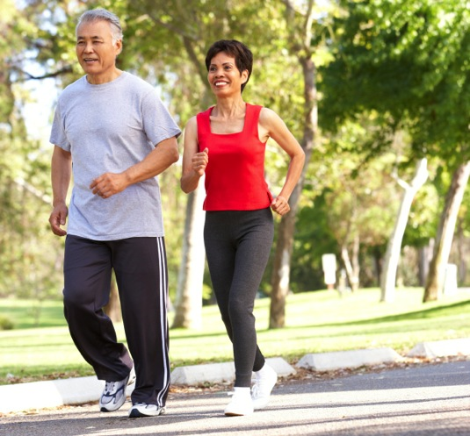
Even two and a half hours a week of exercise is beneficial
Notes:
Studies show that people who are physically active for approximately seven hours a week have a 40-percent lower risk of dying prematurely than those who are active for fewer than 30 minutes a week. There’s even substantially lower risk of premature death when people do two and a half hours of at least moderate-intensity aerobic physical activity a week.
Heart disease and stroke are two of the leading causes of death worldwide. Studies show that a significant reduction in the risk of cardiovascular disease occurs at activity levels equivalent to two and a half hours a week of moderate-intensity physical activity. The evidence is strong that greater amounts of physical activity up to one hour per day result in further reductions in risk of cardiovascular disease.

Slide 6
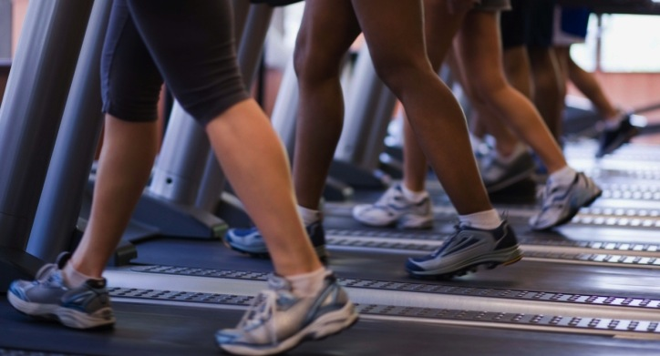
Physical activity up to 1 hour /day results in further risk reduction of cardiovascular disease.
Notes:
Physical activity up to 1 hour /day results in further risk reduction of cardiovascular disease

Slide 7
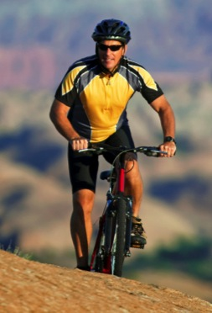
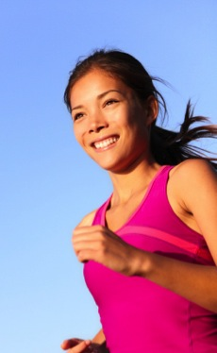
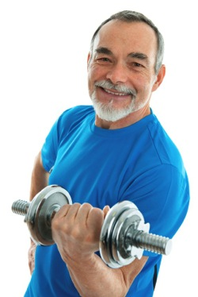
Decline in bone density can be slowed with regular physical activity
Notes:
The decline in bone density during aging can be slowed with regular physical activity beginning at one and a half hours a week and continuing up to five hours a week. Research studies of physical activity to prevent hip fracture show that participating in two to five hours of physical activity per week of at least moderate intensity is associated with reduced risk.

Slide 8
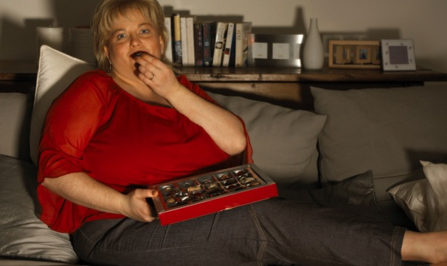
Metabolic Syndrome (hypertension, abdominal obesity, adverse lipid profile, impaired glucose tolerance) responds to regular physical activity, restrictive diet and appropriate medications.
Notes:
Metabolic Syndrome is a condition in which people have a combination of high blood pressure, a large waistline (abdominal obesity), an adverse blood lipid profile (low levels of high-density lipoprotein [HDL] cholesterol, raised triglycerides), and impaired glucose tolerance. Studies have shown that people with metabolic syndrome respond to persistent, regular physical activity; a restrictive diet; and appropriate medications.³ Other studies show that those who regularly engage in at least two to two and a half hours a week of moderate-intensity aerobic activity have a lower risk of developing type 2 diabetes than do inactive people.

Slide 9
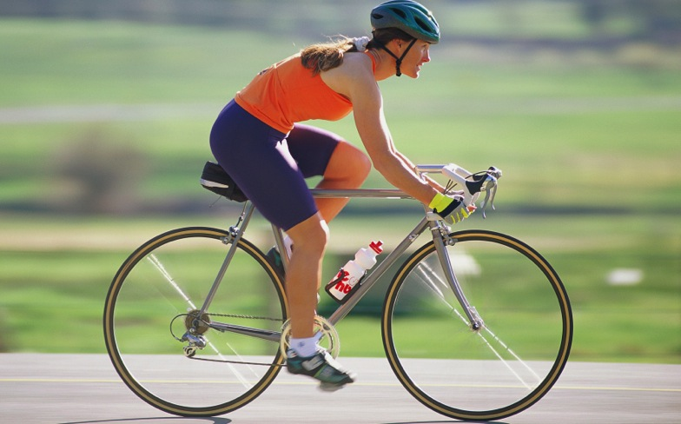
Physical activity is a critical factor in maintaining a healthy body weight.
Notes:
Overweight and obesity occur when calories ingested through food and beverages are more than calories used. Research shows that within the space of a year it’s possible to achieve weight stability through two and a half to five hours per week of walking at a pace of about four miles per hour. Such physical activity is a critical factor in determining whether a person can maintain a healthy body weight, lose excess body weight, or maintain successful weight.

Slide 10
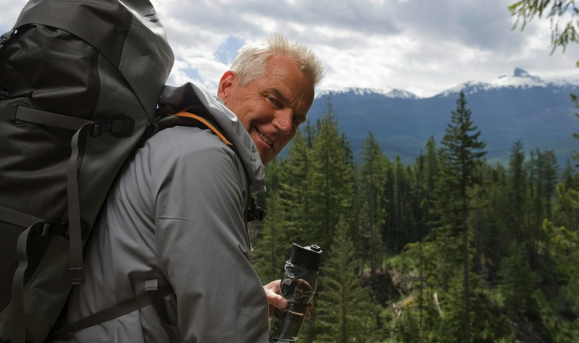
If you want to postpone your funeral, exercise regularly!
Notes:
Health benefits of physical activity far outweigh the risk of adverse events for almost everyone. Adults with chronic disabilities should consult their health-care provider about the types and amounts of activity appropriate for them. As long as the activity is within one’s ability, it should be safe. In other words, if you want to postpone your funeral, exercise regularly!

Slide 11
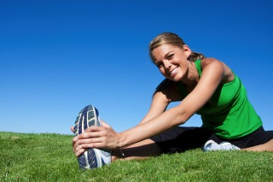
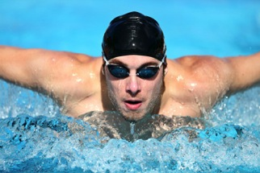
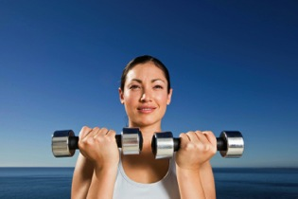
Three types of physical exercises
flexibility
aerobic
resistance
Notes:
Physical exercises are generally grouped into three types⁴ and have different effects on the body:
Flexibility exercises, such as stretching, improve the range of motion of muscles and joints.⁵
Aerobic exercises, such as cycling, swimming, walking, skipping rope, rowing, running, hiking, or playing tennis, focus on increasing cardiovascular endurance;⁶ however, weight-bearing aerobic exercise, such as walking, climbing, and jogging, increases bone density.
Resistance exercises, such as weight training, increase muscle strength⁷ and lower or prevent bone loss associated with menopause.⁸

Slide 12
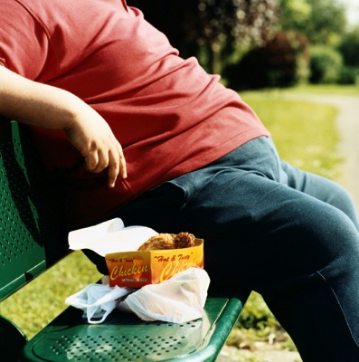
Four levels of physical activity
Inactive—no additional activity beyond baseline (basic routine activities)
Notes:
The 2008 PAGA Advisory Committee report provides the basis for dividing the amount of weekly aerobic physical activity for adults into four levels:
1. Inactive—no additional activity beyond baseline (basic routine activities)

Slide 13
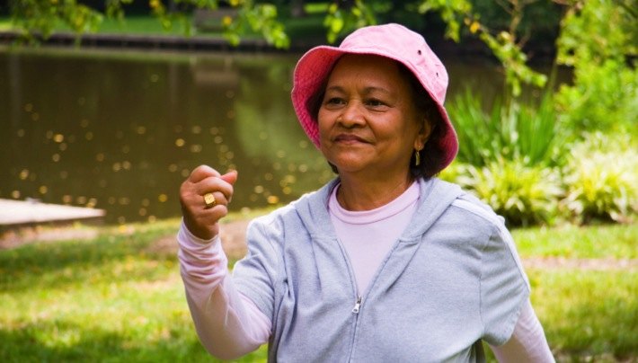
Low—some exercise, up to 150 minutes/week
3. Medium—exercise 150-300 minutes/ week
Notes:
Low—some exercise, up to 150 minutes a week
Medium—exercise 150 to 300 minutes a week

Slide 14
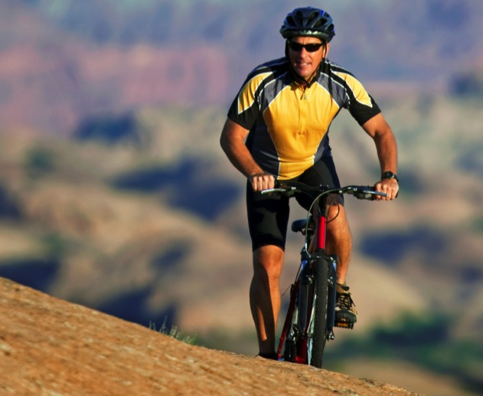
4. High—exercise more than 300 minutes a week
Notes:
4. High—exercise more than 300 minutes a week

Slide 15
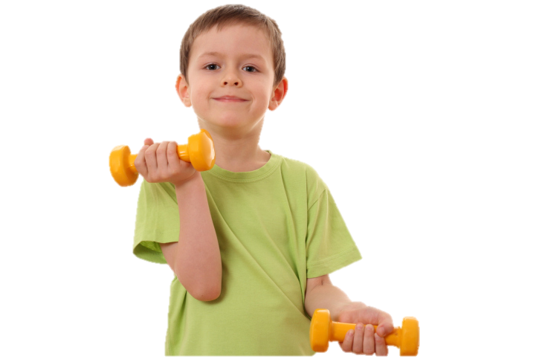
Rule of thumb
Low activities—some benefit
Medium activities—substantial benefit
High activities—greater benefit
Notes:
These categories provide a rule of thumb for how the total amount of physical activity is related to health benefits. Low amounts of activity provide some benefit; medium amounts provide substantial benefit; and high amounts provide even greater benefit. If a person has not been exercising regularly, it’s important to obtain health clearance from a physician before embarking on such a program.

Slide 16
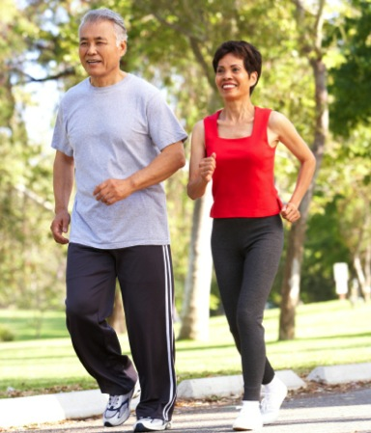
How do we know the intensity of our exercise? It is moderate when you can maintain a comfortable conversation during the activity!
Notes:
How do we know the intensity of our exercise? As a rule of thumb, a person doing moderate-intensity aerobic activity can maintain a comfortable conversation during the activity. A person doing vigorous-intensity activity cannot say more than a few words without pausing for a breath.
Health benefits have not yet been proved for activities such as stretching, warming up, or cooling down, but they often are used in physical activity programs.

Slide 17
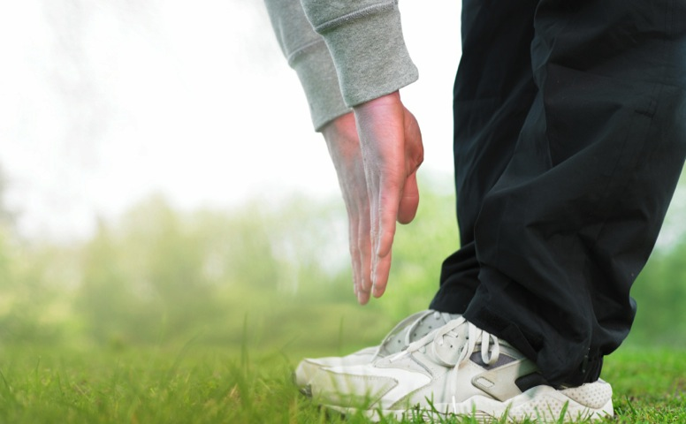
Health benefits of physical activity far outweigh the risks
Notes:
Although physical activity has many health benefits, injuries and other adverse events do sometimes occur. The most common injuries affect the musculoskeletal system (bones, joints, muscles, ligaments, and tendons). Others problems, such as overheating and dehydration, may occur during activity. The good news is that scientific evidence strongly shows that appropriate physical activity is safe for almost everyone, and that the health benefits of physical activity far outweigh the risks.

Slide 18
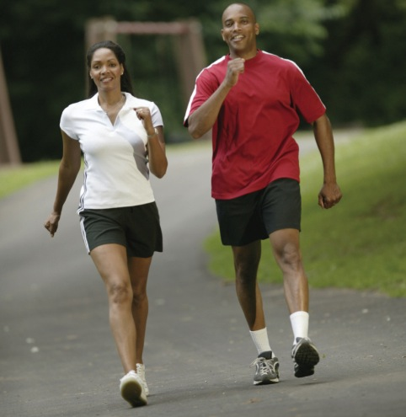
Walking is the best physical activity
Notes:
The current Physical Activity Guidelines for Americans encourage a person to accumulate at least two and a half hours a week in moderate-intensity physical activity, such as brisk walking. Dr. Kenneth Cooper, of Aerobics fame, promotes brisk walking rather than running or jogging. Walking appeals to many because it can be done almost any time or place. It’s fun, convenient, inexpensive, and can be enjoyed alone or with friends. It requires no special equipment. Comfortable walking shoes and clothing are all that is needed. Brisk walking results in minimal injuries while exercising most muscles and systems of the body. It stimulates the release of endorphins, which elevate the mood and improve outlook on life.

Slide 19
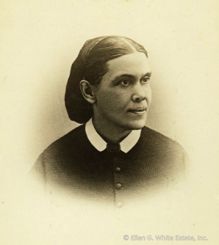
Ellen G. White The Health Reformer July 1, 1872
“Walking, in all cases where it is possible, is the best exercise, because in walking, all the muscles are brought into action.”
Notes:
More than 150 years ago Ellen G. White said, “Walking, in all cases where it is possible, is the best exercise, because in walking, all the muscles are brought into action.”⁹

Slide 20

Proper training clothes
Lightweight, appropriate to climatic conditions, with maximum freedom of movement
Notes:
While exercising one should wear lightweight garments that offer maximum freedom of movement and are appropriate to climatic conditions.

Slide 21

Brightly colored, reflective materials if exercising in an urban area
Best to dress in layers that can be removed
Notes:
When exercising in an urban area, use brightly colored garments and reflector materials for safety.

Slide 22
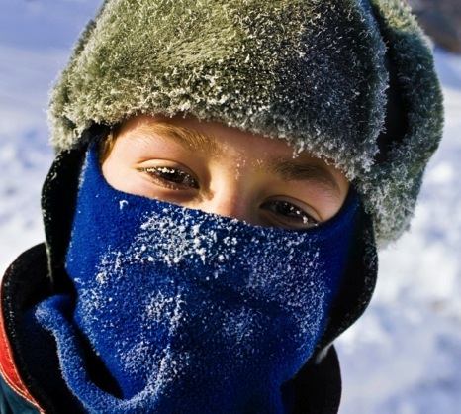
If it’s very cold, consider wearing a face mask or scarf to warm the air before it enters the lungs
Notes:
Exercise generates heat, so it’s better to dress in layers that can be removed as soon as one starts perspiring. If it’s very cold, consider wearing a face mask or scarf to warm the air before it enters the lungs. A hat or headband will protect the ears, which are vulnerable to frostbite.

Slide 23
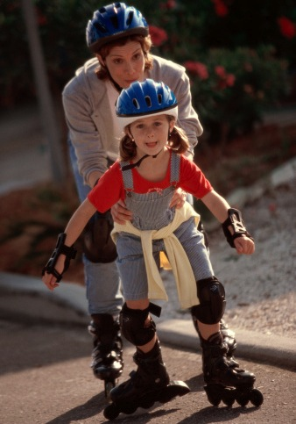
Wear protective gear if doing risky activity: helmet, wrist guards, knee guards
Notes:
It’s vital to wear protective gear, such as helmets, wrist guards, and knee guards, when engaging in physical activities that carry risk of injury, including bicycling, skateboarding, and rollerblading.

Slide 24
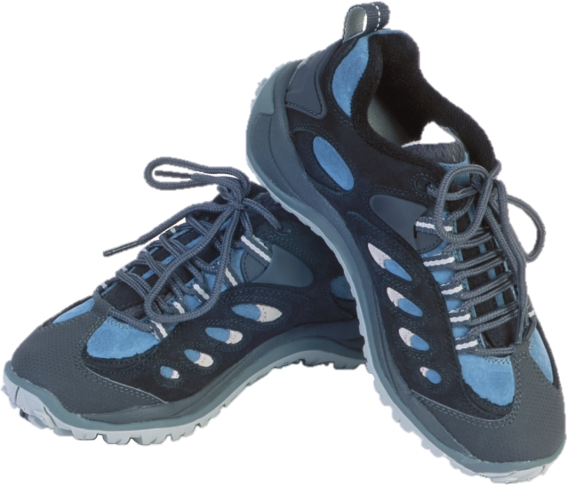
Proper training shoes
Notes:
Feet bear the weight of the whole body, therefore it’s important that shoes be comfortable, well-fitting, and supportive. Look for athletic shoes with absorbent cushioning, appropriate arch support, a solid and snug heel cup, flexibility, breathability, and good lacing so you can adjust tightness without pinching your feet.

Slide 25
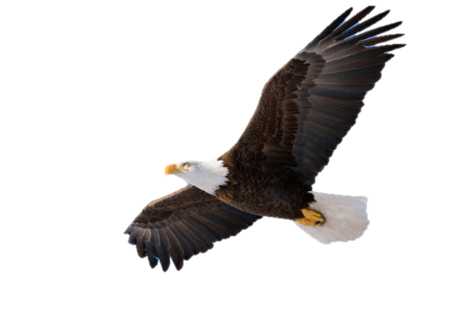
Exercising faith
Even the youths shall faint and be weary, and the young men shall utterly fall, but those who wait on the Lord shall renew their strength; they shall mount up with wings like eagles, they shall run and not be weary, they shall walk and not faint. Isaiah 40:29-31, NKJV
Notes:
As regular aerobic exercise helps us live better, so it is with the exercise of faith. We can trust God to lead our lives according to His loving prescription for health.
He gives power to the weak, and to those who have no might He increases strength. Even the youths shall faint and be weary, and the young men shall utterly fall, but those who wait on the Lord shall renew their strength; they shall mount up with wings like eagles, they shall run and not be weary, they shall walk and not faint (Isa. 40:29-31, NKJV).

Slide 26

LIFE APPLICATION QUESTIONS
Notes:
LIFE APPLICATION QUESTIONS

Slide 27
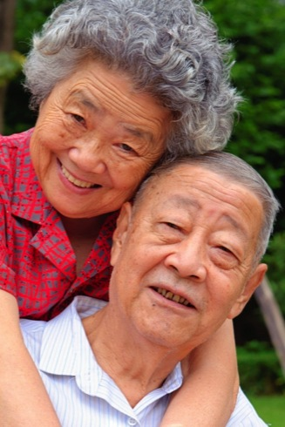
What are the most attractive benefits of regular exercise?
Notes:
What are the most attractive benefits of regular exercise?

Slide 28
What are the most attractive benefits of regular exercise?
How can I live longer with better cognitive function and lower my risk of getting cancer, cardiovascular disease, or diabetes?
Notes:
How can I live longer with better cognitive function and lower my risk of getting cancer, cardiovascular disease, or diabetes?

Slide 29
What are the most attractive benefits of regular exercise?
How can I live longer with better cognitive function and lower my risk of getting cancer, cardiovascular disease, or diabetes?
How does exercise offer better quality of life, less depression, ease of movement, and optimum body mass?
Notes:
How does exercise offer better quality of life, less depression, ease of movement, and optimum body mass?

Slide 30

As I look at my family history are there benefits of exercise that could prevent the adverse history being repeated in my life?
Notes:
As I look at my family history are there benefits of exercise that could prevent the adverse history being repeated in my life?

Slide 31

Am I going to make the choice to exercise with these goals as motivating factors?
Notes:
Am I going to make the choice to exercise with these goals as motivating factors?

Slide 32
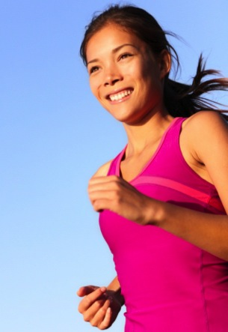
How much exercise am I currently getting per week?
Notes:
How much exercise am I currently getting per week?

Slide 33
How much exercise am I currently getting per week?
What level of exercise am I achieving?
Notes:
What level of exercise am I achieving?

Slide 34
How much exercise am I currently getting per week?
What level of exercise am I achieving?
Do I need to choose to exercise for longer periods each day, or can I increase the level of activity?
Notes:
Do I need to choose to exercise for longer periods each day, or can I increase the level of activity?

Slide 35
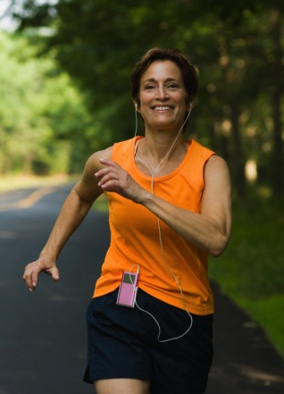
What activity can I do along with exercises such as walking to maximize my use of time?
Notes:
What activity can I do along with exercises such as walking to maximize my use of time?

Slide 36
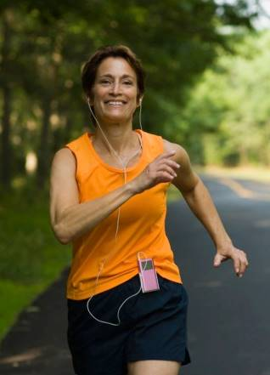
Should I use the time for personal growth, possibly spiritual, by listening to an audio version of the Bible or devotional books?
Notes:
Should I use the time for personal growth, possibly spiritual, by listening to an audio version of the Bible or devotional books?

Slide 37
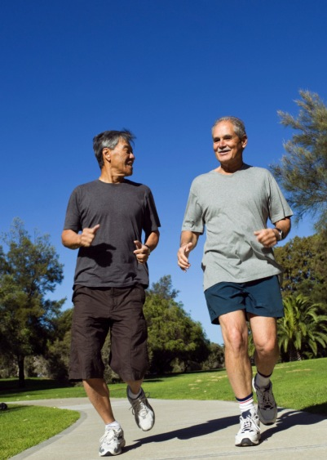
What benefits would come from exercising with friends?
Notes:
What benefits would come from exercising with friends?

Slide 38
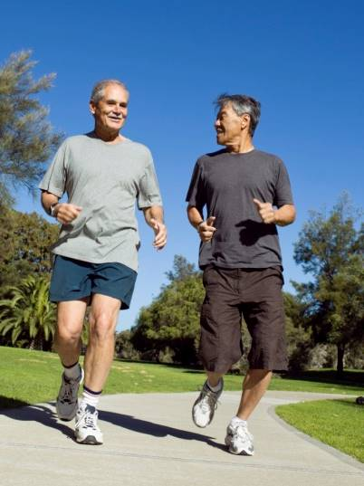
Would I be able to maintain some long-distance relationships by talking on the phone while doing moderate-intensity aerobic exercise?
Notes:
Would I be able to maintain some long-distance relationships by talking on the phone while doing moderate-intensity aerobic exercise?

Slide 39

How can I become better motivated to exercise regularly?
Notes:
How can I become better motivated to exercise regularly?

Slide 40
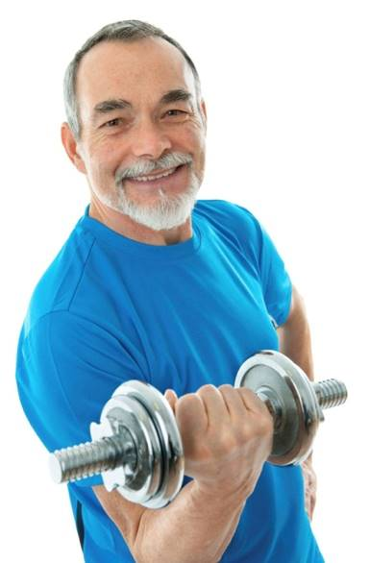
What types of exercise achieve flexibility, cardiovascular fitness, and improved bone health?
Notes:
What types of exercise achieve flexibility, cardiovascular fitness, and improved bone health?

Slide 41
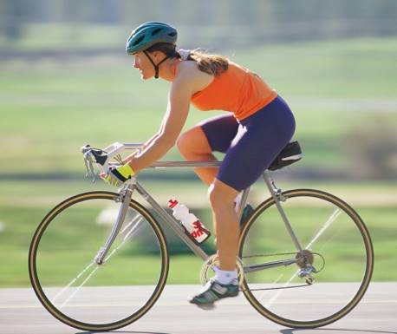
Which of the three types will I start today?
When will I include the next type of exercise?
Notes:
Which of the three types will I start today?
When will I include the next type of exercise?

Slide 42
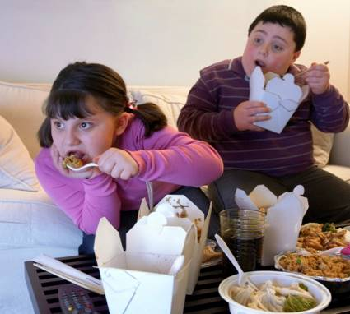
The children of Margaret’s neighbor have a problem with their weight, and Margaret is worried that they are at risk for diabetes.
She wants to give them a gift at Christmas.
Notes:
The children of Margaret’s neighbor have a problem with their weight, and Margaret is worried that they are at risk for diabetes. She wants to give them a gift at Christmas.

Slide 43
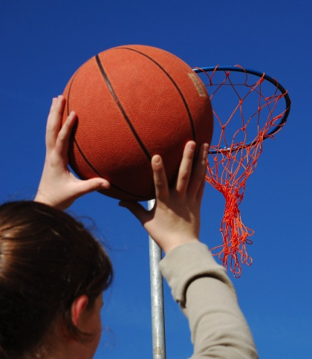
What should she get that would make exercise fun for them?
Notes:
What should she get that would make exercise fun for them?

Slide 44
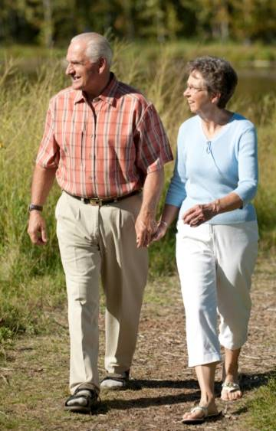
Do I have a spouse who needs to be encouraged to exercise?
Can we make time to walk together, thereby adding more bonding time to our marriage as well?
Notes:
Do I have a spouse who needs to be encouraged to exercise?
Can we make time to walk together, thereby adding more bonding time to our marriage as well?

Slide 45
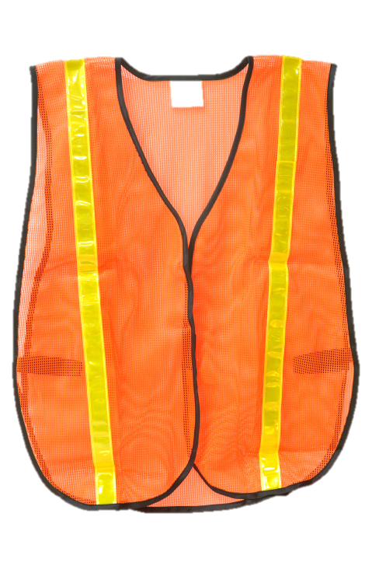
What is the best clothing and shoes for exercise activities?
What will keep me safe in a busy city, at night, or during winter?
Notes:
What is the best clothing and shoes for exercise activities? What will keep me safe in a busy city, at night, or during winter?

Slide 46

I sometimes find it hard to choose to exercise on a daily basis.
How can I obtain spiritual strength to make this a priority in my life?
Notes:
I sometimes find it hard to choose to exercise on a daily basis. How can I obtain spiritual strength to make this a priority in my life?

Slide 47

Celebrating liquids
Notes:
Li Ming was a retired woman who enjoyed working in her garden. Even the unusual heat wave that hit her region one summer didn’t deter her from tending her flowers and other plants. The temperature rose above 100 degrees Fahrenheit, and the humidity teetered at 90 percent. On the third day of these record-breaking temperatures, Li Ming called her daughter, Kim, but Li Ming sounded confused on the phone. Kim became alarmed and rushed to Li Ming’s house, where she found her mother lying on the kitchen floor, unconscious. Apparently, Li Ming’s large fan wasn’t enough to fight the effects of the heat and humidity, and she suffered heat stroke—which can be life threatening.¹

